Slide 1
RAD (Rapid Application Development)

Slide 2
The RAD (Rapid Application Development) model is based on prototyping and iterative development with no specific planning involved. The process of writing the software itself involves the planning required for developing the product.
Rapid Application Development focuses on gathering customer requirements through workshops or focus groups, early testing of the prototypes by the customer using iterative concept, reuse of the existing prototypes (components), continuous integration and rapid delivery.

Slide 3
What is RAD?
Rapid application development is a software development methodology that uses minimal planning in favor of rapid prototyping. A prototype is a working model that is functionally equivalent to a component of the product.
In the RAD model, the functional modules are developed in parallel as prototypes and are integrated to make the complete product for faster product delivery. Since there is no detailed preplanning, it makes it easier to incorporate the changes within the development process.

Slide 4
RAD projects follow iterative and incremental model and have small teams comprising of developers, domain experts, customer representatives and other IT resources working progressively on their component or prototype.
The most important aspect for this model to be successful is to make sure that the prototypes developed are reusable.

Slide 5
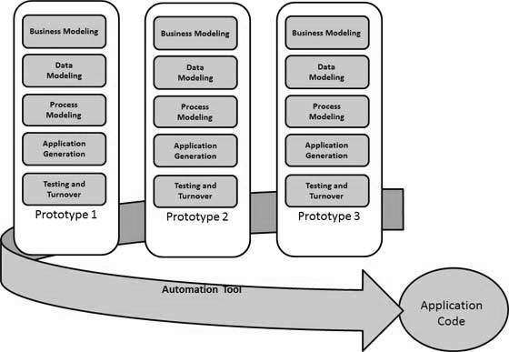

Slide 6
Following are the various phases of the RAD Model −

Slide 7
Business Modelling
The business model for the product under development is designed in terms of flow of information and the distribution of information between various business channels. A complete business analysis is performed to find the vital information for business, how it can be obtained, how and when is the information processed and what are the factors driving successful flow of information.

Slide 8
Data Modelling
The information gathered in the Business Modelling phase is reviewed and analyzed to form sets of data objects vital for the business. The attributes of all data sets is identified and defined. The relation between these data objects are established and defined in detail in relevance to the business model.

Slide 9
Process Modelling
The data object sets defined in the Data Modelling phase are converted to establish the business information flow needed to achieve specific business objectives as per the business model. The process model for any changes or enhancements to the data object sets is defined in this phase. Process descriptions for adding, deleting, retrieving or modifying a data object are given.

Slide 10
Application Generation
The actual system is built and coding is done by using automation tools to convert process and data models into actual prototypes.

Slide 11
Testing and Turnover
The overall testing time is reduced in the RAD model as the prototypes are independently tested during every iteration. However, the data flow and the interfaces between all the components need to be thoroughly tested with complete test coverage. Since most of the programming components have already been tested, it reduces the risk of any major issues.

